Slide 1
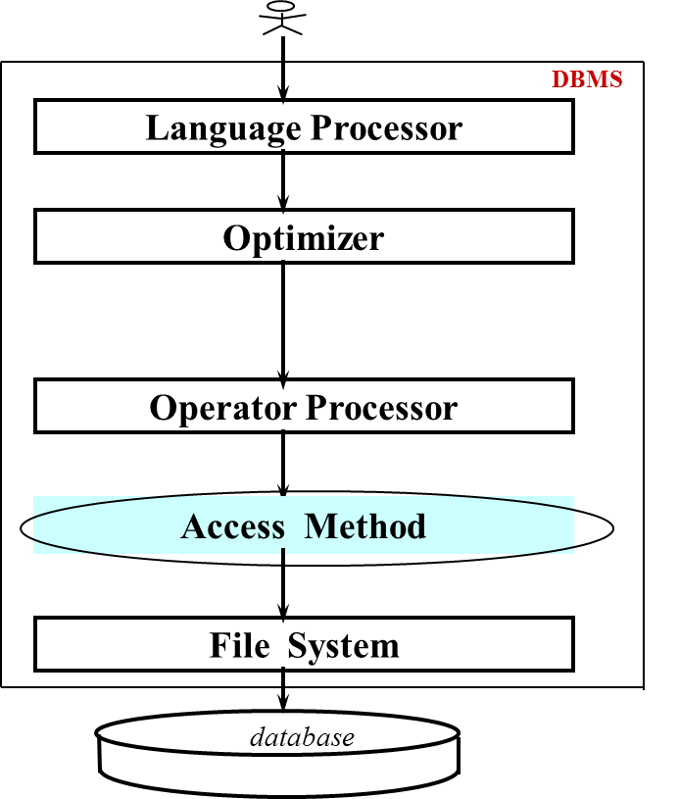
Unit 11
File Organization and
Access Methods

Slide 2
本課程講授內容
    PART I: 入門與導論
      Overview
      DB2系統及SQL語言
      闡述關連式資料模型(The Relational Model)
      階層式資料模型(The Hierarchical Model)簡介
      網狀式資料模型(The Network Model)簡介
    PART II: 資料庫設計 (Database Design)
      資料庫問題分析與 E-R Model
      資料庫的表格正規化
      設計介面增刪查改資料庫
    PART III: 進階探討
      快速存取方法(Access Methods)
      資料庫回復(Database Recovery)
      協同控制(Concurrency Control)
      資料安全與資料正確(Security and Integrity)
      查詢最佳化(Query Optimization)
      分散式資料庫系統(Distributed Database)

Slide 3
PART III: 進階探討
快速存取方法(Access Methods):介紹大量資料庫之所以可以快速存取的技巧及方法，包括最有名的索引系統 B-tree index.
資料庫回復(Database Recovery):介紹萬一系統出問題，導致資料不正確時，如何回復到某一正確點的相關議題。
協同控制(Concurrency Control):通常同一資料庫是允許多人同時共用的，本單元探討DBMS是如做控制使得多人共同而不互相干擾。
資料安全與資料正確(Security and Integrity): 資料安全是指保護資料不讓未授權的人偷竊、破壞;資料正確是指保護資料不讓已有授權的合法使用者誤用，例如把存款餘額變成負數。
查詢最佳化(Query Optimization):查詢資料庫某一問題可以有不同的查詢指令。不同的指令查詢時間可能相差好幾倍，本單元介紹撰寫最佳化的查詢語言指令的方法。
分散式資料庫系統(Distributed Database): 分散式資料庫是透過電腦網路將多個資料庫連線起來組成的資料庫。現今我們用的系統有太多的分散式資料庫系統，本單元將介紹之，探討它的優缺點。
擴充E-R Model: 一般不太複雜的問題，前面介紹的E-R Model基本上就夠用。但大系統或比較特殊的系統就必須有更多功能的擴充式E-R Model(Extended E-R Model,簡稱EER-model)可處理包括Specialization、Generalization、Aggregation等問題。
進階表格正規化: 關連式資料庫是由許多表格(tables)組成的，表格要正規化。正規化分六級，一般也許到第三級正規化即可。理論上還有BCNF級、第四級、第五級的正規化。本單元要介紹這些特例。當年這些是博士論文級的問題探討。

Slide 4
    Contents of PART III: 進階探討
Unit 11 Access Methods
Unit 12 Database Recovery
Unit 13 Concurrency Control
Unit 14 Security and Integrity
Unit 15 Query Optimization
Unit 16 Distributed Database
Unit 17 More on E-R Model
Unit 18 More on Normalization
Unit 19 More on User Interfaces
Unit 20 More on X?
References:
1. C. J. Date, An Introduction to Database Systems, 8th edition, Addison-Wesley, 2004.
2. A. Silberschatz, etc., Database System Concepts, 5th edition, McGraw Hill, 2006.
3. J. D. Ullman and J. Widom, A First Course in Database Systems, 3rd edition, Prentice Hall, 2007.
4. Cited papers (講義中提到之參考文獻)

Slide 5
Contents
11.1 Introduction
11.2 Indexing
11.3 Hashing
11.4 Pointer Chains
11.5 Compression Techniques
11.6 Differential File Organization

Slide 6
大量資料存取方法之研究
Approaches to Access/Store Large Data
楊維邦 博士
國立交通大學
資訊科學系所教授

Slide 7
11.1 Introduction to Access Methods

Slide 8
The Role of Access Method in DBMS
  Query in SQL:
  SELECT CUSTOMER. NAME
  FROM CUSTOMER, INVOICE
  WHERE REGION = 'N.Y.' AND
  AMOUNT > 10000 AND
  CUSTOMER.C#=INVOICE.C#
  DBMS
Language Processor
  Internal Form:
      Π(σ (S SP)
Optimizer
  Operator:
  SCAN C using region index, create C
  SCAN I using amount index, create I
  SORT C?and I?on C#
  JOIN C?and I?on C#
  EXTRACT name field
Operator Processor
Calls to Access Method:
OPEN SCAN on C with region index
GET next tuple
.
.
.
Calls to file system:
GET10th to 25th bytes from
block #6 of file #5
Access Method
File System
database

Slide 9
The Internal Level
  Objectives:
    concern the way the data is actually stored.
    store data on direct access media. e.g. disk.
    minimize the number of disk access (disk I/O).
    disk access is much slower than main storage access time.
  Storage Structure/File Structure:
    many different storage structures:
      <e.g> indexing, hashing, pointer chains, …
    different structures have different performance
    => no single structure is optimal for all applications.
    => a good DBMS should support a variety of different structures (Access Methods)
Main
Disk
Buffer I/O
index
CPU
index

Slide 10
The Internal Level (cont.)
  Physical database design:
    Process of choosing an appropriate storage representation for a given database (by DBA). E.g. designing B-tree or hashing
    Nontrivial task
      require a good understanding of how the database will be used.
  Logical database design: (Unit 6,7)
S P SP
data
S P-SP

Slide 11
11.2 Indexing (1)

Slide 12
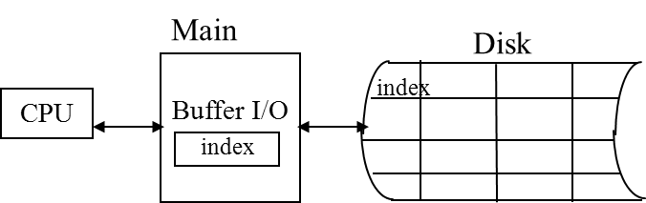
Indexing: Introduction
  Consider the Supplier table, S.
  Suppose "Find all suppliers in city xxx" is an important query.
  i.e. it is frequency executed.
    => DBA might choose the stored representation as Fig. 11.2.
City-Index (index)
S (indexed file)
Athens
S1
Smith
20
London
London
S2
Jones
10
Paris
London
S3
Blake
30
Paris
Paris
S4
Clark
20
London
Paris
S5
Adams
30
Athens
Fig. 11.2: Indexing the supplier file on CITY.

Slide 13
Indexing: Introduction (cont.)
  Now the DBMS has two possible strategies:
  <1> Search S, looking for all records with city = 'xxx'.
  <2> Search City-Index for the desired entry.
  Advantage:
      speed up retrieval.
      index file is sorted.
      fewer I/O's because index file is smaller.
  Disadvantages:
      slow down updates.
      both index and indexed file should be updated.

Slide 14
Indexing: Multiple Fields
  Primary index : index on primary key. <e.g> s#
  Secondary index: index on other field. <e.g> city
  A given table may have any number of indexes.
CITY-index
S
Status-index
Athens
S1
Smith
20
London
10
London
S2
Jones
10
Paris
20
London
S3
Blake
30
Paris
20
Paris
S4
Clark
20
London
30
Paris
S5
Adams
30
Athens
30
Fig. 11.3: Indexing the supplier file on both CITY and STATUS.

Slide 15
How Index are used?
Consider:
<1> Sequential access :
accessed in the sequence defined by
values of the indexed field.
City-Index
S (indexed file)
Athens
...
London
S1
...
<e.g> Range query : "Find the suppliers whose
city begins with a letter in the range L-R."
London
S2
...
...
Paris
London
S3
...
...
Paris
<2> Direct Access :
<e.g> "Find suppliers in London."
<e.g> list query:"Find suppliers whose city
is in London, Paris, and N.Y."
Paris
S4
...
...
London
Paris
Athens
S5
...
...
<3> Existence test :
<e.g> "Is there any supplier in London ?"
Note: It can be done from the index alone.

Slide 16
Indexing on Field Combinations
  To construct an index on the basis of values of two or more fields.
  <e.g.>
City/Status-Index
S
Athens/30
S1
Smith
20
London
London /20
S2
Jones
10
Paris
London /20
S3
Blake
30
Paris
Paris /10
S4
Clark
20
London
Paris/30
S5
Adams
30
Athens
Query: “Find suppliers in Paris with status 30.”
- on city/status index: a single scan of a single index.
- on two separate indexes: two index scan => still difficult. (Fig. 11.3)

Slide 17
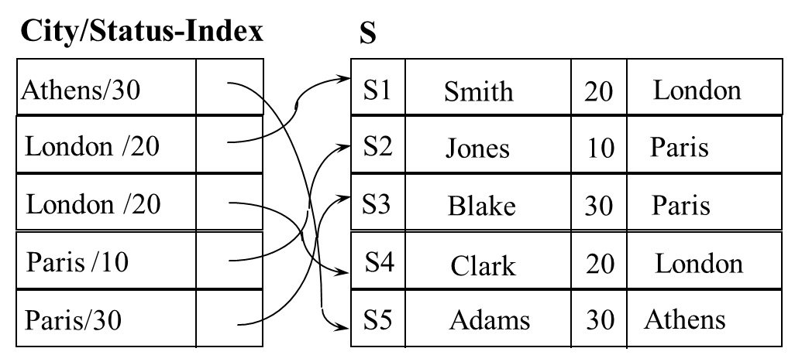
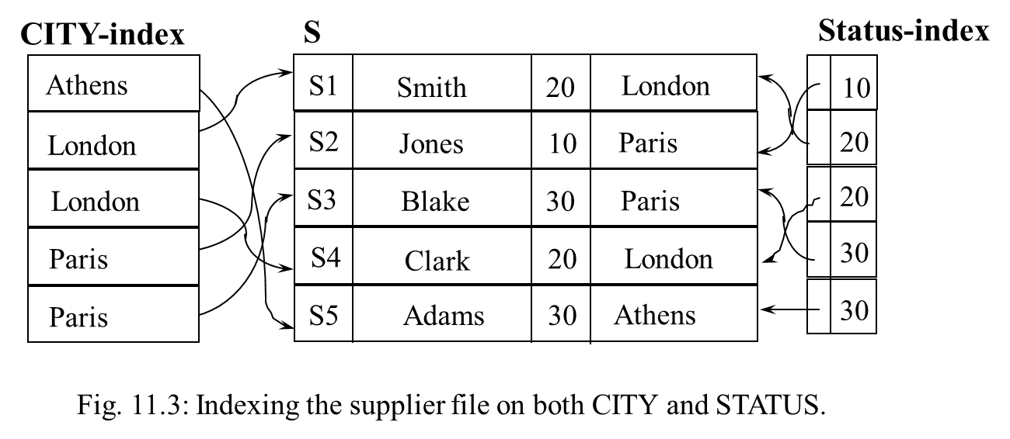
Query1: “Find suppliers in Paris with status 30”
Query2: “Find suppliers with status 30”
Query3: “Find suppliers in Paris”

Slide 18
Indexing on Field Combinations (cont.)
<Note>
  1. Combined city/status index can serve as an index on
  the city field alone.
  2. In general, an index on the combination of fields
  F1 F2 ....Fn can serve as indexes on
  - F1 alone
  - F1 F2 or F2 F1
  - F1 F2 F3 or any combinations
  -
<Think>: How many indexes can F1....Fn serve as ?
.
.
.

Slide 19
11.2 Indexing (2)
Dense vs. Nondense Indexing
B-tree and B⁺-tree

Slide 20
Dense V.S. Nondense Indexing
  Assume the Supplier file (S) is clustered on S# .
Index (dense)
S1
S2
S3
S4
S5
S6
S
page1
page2
page3
S1...
S2...
S3...
S4...
S5...
S6...
S
S# SNAME STATUS CITY
S1 Smith 20 London
S2 Jones 10 Paris
S3 Blake 30 Paris
S4 Clark 20 London
S5 Adams 30 Athens
City_index
S1
S3
S5
A L L P P
Index (nondense)

Slide 21
Dense V.S. Nondense Indexing (cont.)
  Nondense index: not contain an entry for every record in the indexed file.
    retrieval steps:
    <1> scan the index (nondense) to get page # , say p. <2> retrieve page p and scan it in main storage.
    advantages:
    <1> occupy less storage than a corresponding dense index
    <2> quicker to scan.
    disadvantages: can not perform existence test via index alone.
  Note: At most only one nondense index can be constructed. (why?)
  Clustering: logical sequence = physical sequence

Slide 22
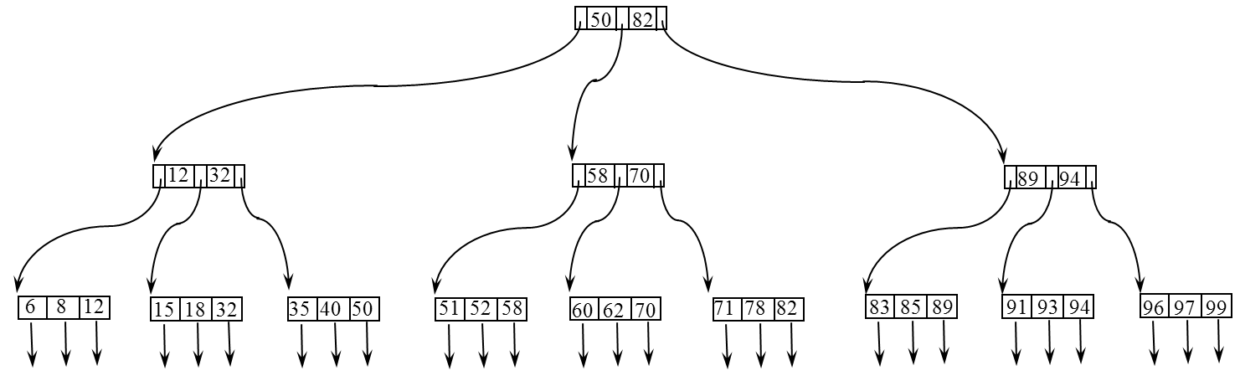
B-tree
  Introduction:
    is a particular type of multi-level
    (or tree structured) index.
    proposed by Bayer and McCreight in 1972.
    the commonest storage structure of all
    in modern DBMS.
  Definition: (from Horowitz "Data Structure")
  A B-tree T of order m is an m-way search tree, such that
    <1> the root node has at least 2 children.
    <2> non-leaf nodes have at least [m/2] children.
    <3> all leave nodes are at the same level.
  Goal: maintain balance of index tree by dynamically restructuring the tree as updates proceed.

Slide 23
96 97 99
B-tree (cont.)
  Definition: (from Horowitz "Data Structure")
  A B-tree T of order m is an m-way search tree, such that
    <1> the root node has at least 2 children.
    <2> non-leaf nodes have at least [m/2] children.
    <3> all leave nodes are at the same level.
  Goal: maintain balance of index tree by dynamically restructuring the tree as updates proceed.
89 94
91 93 94
83 85 89
71 78 82
100
50 82
58 70
60 62 70
100x100
=10,000
51 52 58
100x100x100
=1,000,000
pointers to data records
pointers to data records
pointers to data records
35 40 50
12 32
15 18 32
6 8 12

Slide 24
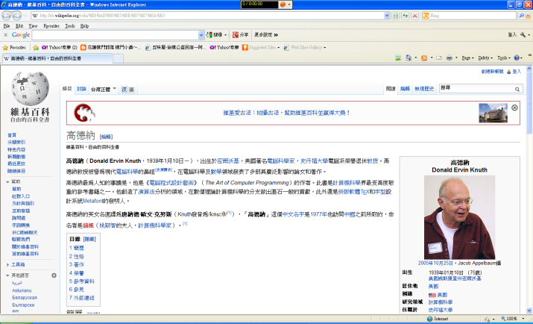
B⁺-tree (Knuth's variation)
96 97 99
89 94
91 93 94
83 85 89
71 78 82
index set
(nondense)
50 82
58 70
60 62 70
-
51 52 58
Sequence set
(with pointers
to data records)
(dense or nondense)
- index set: provides fast direct access to the sequential set
and thus to the data too.
- sequence set: provides fast sequential access to the indexed data.
35 40 50
12 32
Other variations: B*-tree, B'-tree,...
15 18 32
6 8 12

Slide 25
11.3 Hashing
11.3.1 Dynamic Hashing
11.3.2 Extendible Hashing
11.3.3 Linear Hashing

Slide 26
Hashing: Introduction
  Hashing (or Hash Addressing )
    is a technique for providing fast direct access to a specific stored record on the basis of a given value for some fields.
    The field is usually but not necessarily the primary key
      Key Space Address Space (disk)
h(k3)=38
h(k) = k mod 100
k1=2182
3238
h(k)
38
k2=5199
2182
k3=3238
82
k4=6582
h(k1)=82
5199
Input:3238
K₅=6638
hash field k
99
h(k2)=99
h: map key set to address space.

Slide 27
Hashing: Introduction (cont.)
  Basic Idea:
      Apply key-to-address transformation to determine in which bucket a record should be placed.
      partition storage space into buckets, each holds one or more records.
      handle bucket overflow
  to store:
      DBMS computes the hash address (RID or page #) for the new record.
      DBMS instructs the file manager to place the record at that position.
  to retrieve:
      given a key, the DBMS computes the hash address as before
      Using the computed address, DBMS instructs the file manager to fetch the record.
  Advantages:
      fast.
      no space overhead as index method
  Disadvantages:
      physical sequence primary key sequence.
      Collisions:
f(k1) = f(k2), k1 k2

Slide 28
Address Transformation Algorithms
    Convert key value into value of appropriate magnitude.
    <e.g> 'Smith‘ => Asc('s') + Asc('m') + Asc('i') + Asc('t‘) + Asc('h')
    Common algorithms:
      Division Method:
        H(k) = modulo (k /n)
      Mid-square method:
        H(k) = central digits of
      Others: ......
    Observation:
      Division method is good enough.
Hash function
K1
K2
...
K10
n
0000001
9999999
e.g. H(k) = k mod 100
F(x) = x
e.g. k = 525 = 275625
Too waste!! m
F(k)= k mod 120
0
α= n/m ~ 0.8
loading factor
n=100
120
m

Slide 29
Overflow Handling in Hashing
  Overflow chaining:
    allocate new bucket and chain to overflow bucket.
.
.
.
h(x)
primary
bucket
overflow
bucket
.
.
.
overflow
bucket
...

Slide 30
Overflow Handling in Hashing (cont.)
  Open addressing:
    make use of empty slots in the next bucket.
    many variations
  Perfect hashing: one-to-one mapping.
901
}
bucket 1 full
821
h(471)
242
}
bucket 2 not full
471
h
k4
k2
k1
k3
k1
k2
k3
k4

Slide 31
Perfect Hash Function
  Rank Methods
    [Ghosh 77] h( , , ..., ) = m + t( ; ) + * ( , ; , ) + ...
  Reduction Methods
    [Sprugnoli 77] h( ) =
    [Sprugndi 77] h(k) =
  Value Assignment Methods
    [Cichelli 80] Hash value key length + f(1st char) + f(last c)
    [Jaeschke 80] Counter-example
    [Cook 82] improve Cichelli's method
  Reprocal Methods
    [Jaeschke 81] h(k) = mod n
    [Chang 84] h( ) = C mod P( )
  Hash Indicator Table [HIT] Methods
    [Du 80, Du 83] h( ) = hj( ) = xi if HIT[ht( )] t t < j and HIT[hj( )] = j
    [Yang 83, Yang 85]

Slide 32
Perfect Hash Function (cont.)
BIT 25(1985), 148-161
A BACKTRACKING METHOD FOR CONSTRUCTING
PERFECT HASH FUNCTIONS FROM A SET OF
MAPPING FUNCTIONS
W. P. YANG and M. W. DU
Institute of Computer Engineering, National Chiao Tung University, 45 Po Ai Street, HsinChu,
Taiwan, Republic of China

Slide 33
11.3.1 Dynamic Hashing
  Definition
      Dynamic Hashing: in the hashing scheme the set of keys can be varied, and the address space is allocated dynamically.
  How to achieve it ?
      using a auxiliary table (e.g. index tree, bit-map table, prefix tree, directory, ...)
  Problems?
      size (utilization)
      retrieval time (disk access times)
      algorithms
KS
AS
KS
AS
1
k1
2
k1
1
k2
n < m
h
2
.
.
.
h
.
.
.
.
.
.
α=0.8=n/m
.
.
.
kn
kn
.
.
.
m
m
kn'
m'
KS
auxiliary table
AS
k1
1
k2
.
.
.
m
m'
m''

Slide 34
Dynamic Hashing: Schemes
    (1) Expandable Hashing
      Knott, G. D. Expandable Open Addressing Hash Table Storage and Retrieval. Proc. ACM SIGFIDET Workshop on Data Description, Access, and Control, 186-206, 1971.
    (2) Dynamic Hashing
      Larson, P. A. Dynamic Hashing. BIT 18(1978) ,184-201.
      Scholl, M. New File Organization Based on Dynamic Hashing. ACM Trans. on Database Systems, 6, 1(March 1981), 194-211.
    (3) Virtual Hashing
      Litwin, W. Virtual Hashing: A Dynamically Changing Hashing. Proc. 4th Conf. on Very Large Data Bases, West Berlin, Sept. 1978, 517-523.
    (4) Linear Hashing
      Litwin, W. Linear Hashing: A New Tool for File and Table Addressing. Proc. 6th Conf. on Very Large Data Bases, 212-223, Montreal, Oct. 1980.
      Larson, P. A. Linear Hashing with Partial Expansions. Proc. 6th Conf. on Very Large Data Bases, Montreal, Oct. 1980, 224-232
      Larson, P. A. Performance Analysis of Linear Hashing with Partial Expansions. ACM Trans. on Database Systems, 7, 4(Dec. 1982), 566-587.

Slide 35
Dynamic Hashing: Schemes (cont.)
  (5) Trie Hashing
    Litwin, W. Trie Hashing. Res. Rep. MAP-I-014, I.R.I.A. Le Chesnay, France, 1981. (also in Proc. 1981 ACM SIGMOD International Conference on Management of Data)
  (6) Extendible Hashing
    Fagin, R., Nievergelt, J., Pippenger, N., and Strong, H. R. Extendible Hashing - A Fast Access Method for Dynamic Files. ACM Trans. Database System 4, 3(Sept. 1979), 315-344.
    Tamminen, M. Extendible Hashing with Overflow. Information Processing Lett. 15, 5(Dec. 1982), 227-232.
    Mendelson, H. Analysis of Extendible Hashing. IEEE Trans. on Software Engineering, SE-8, 6(Nov. 1982), 611-619.
    Yao, A. C. A Note on the Analysis of Extendible Hashing. Information Processing Letter 11, 2(1980), 84-86.
  (7) HIT (Hash Indicator Table) Method
    Du, M. W., Hsieh, T. M., Jea, K. F., and Shieh, D. W. The Study of a New Perfect Hash Scheme. IEEE Trans. On Software Engineering, SE-9, 3(May 1983), 305-313.
    Yang, W. P., and Du, M. W. Expandable Single-Pass Perfect Hashing. Proc. of National Computer Symposium, Taiwan, Dec. 1983, 210-217.
    Yang, W. P., and Du, M. W. A Dynamic Perfect Hash Function Defined by an Extended Hash Indicator Table. Proc. 10th Conf. on Very Large Data Bases, Singapore, Aug. 1984.
    Yang, W. P. Methods for Constructing Perfect Hash Functions and its Application to the Design of Dynamic Hash Files. Doctor Thesis, National Chiao Tung University, Hsinchu, Taiwan, ROC, June 1984.
(8) ‧‧‧

Slide 36
Virtual Hashing
  (Ref: "Virtual Hashing: A dynamically changing hashing", conf. VLDB 1978)
  Basic Idea: If a bucket overflows, split it into 2 buckets, and set a bit to remember it.
B
Bit Map
Example: key set:
{1366, 1256, 2519, 3546, ..., 2916,...}
1 1 1 1 1 1 1 1 1 1 0 0 0 0 0 0 1 0 0 0
0 1 2 3 4 5 6 7 8 9 10 1112 13 14 15 16 17 18 19
level
l= 0
level
l= 1
h₀(key) = R(key, 10)
h₁(key) = R(key, 20)
Buckets
Bucket Size = 3
N = 10
1366
1256
3546
2519
1256
2916
...
...
When insert: 2916
Retrieval: 1256, 1366, 2519
6
9
16
19
0

Slide 37
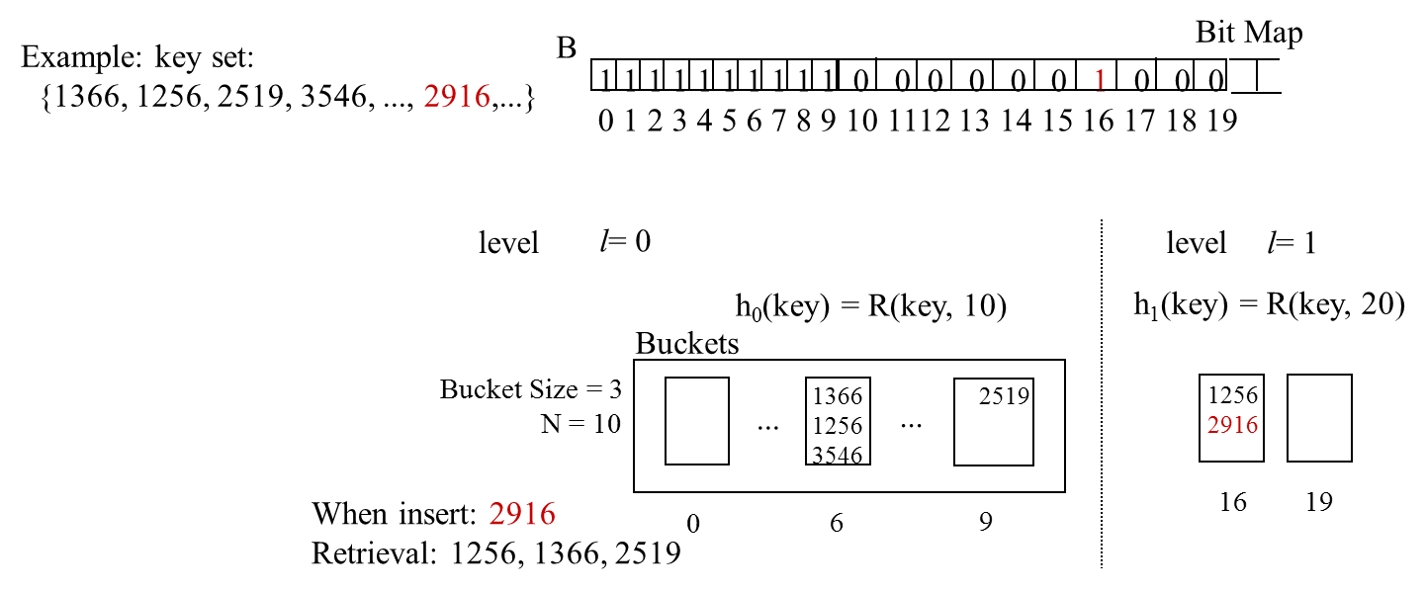
Virtual Hashing (cont.)
  General hash function: h = R(key, 2 · N )
  Algorithm Addressing (key)
l
l
1. Level of (Max j used)
2. m R(key, 2 · N )
3. while B(m) = 0
– 1
m R(key, 2 · N )
4. Return (m)
l
h₂(key) = R(key, 40)
l
l
l

Slide 38
11.3.2 Extendible Hashing
    ( Ref: Fagin, R. et. al. "Extendible Hashing-A fast access method for
    dynamic files", ACM TODS, Vol.4, #3 Sept. 79 )
    Basic idea : Allow number of buckets in a certain key range to vary dynamically based on actual demand.
      Depth(d): the number of the most significant bits in f(k) that will be taken to determine a directory entry.
      -> total number of entries in directory =
      Each entry in directory points to a bucket.
      Each bucket x has a local depth ≦ d
      When a bucket x overflows --> increasing
      if > d -->double directory (i.e. increasing d).
l
x
l
x
l
x

Slide 39
Extendible Hashing: Example
Main Memory
Disk
Directory
Data pages
Depth
3
2
local depth:
000 pointer
First two bits of
pseudokey = 00
001 pointer
00***
010 pointer
3
local depth:
011 pointer
‧
First three bits of
pseudokey = 010
100 pointer
010***
101 pointer
x
3
local depth:
110 pointer
k1
First three bits of
pseudokey = 011
111 pointer
011***
k1=3956;
h(k1) = 56 = 0111000
‧
1
local depth:
k2=4187;
k2
First bit of
pseudokey = 1
h(k2) = 87 = 1010111
.
.
h(k)=1***
x
h(k)=1***...

Slide 40
Extendible Hashing: Example (cont.)
****
0
0***
00**
x
x
1
01**
y
1***
1***
main
disk
main
disk
Data pages
Data pages
Directory
2
Directory
2
Depth g
3
h(-)=00...
Depth g
3
h(-)=00...
000 pointer
001 pointer
010 pointer
011 pointer
100 pointer
101 pointer
110 pointer
111 pointer
000 pointer
001 pointer
010 pointer
011 pointer
100 pointer
101 pointer
110 pointer
111 pointer
3
3
h(-)=010...
‧
m
m'
h(-)=010...
‧
3
3
k
h(-)=011...
h(-)=011...
*
1
*
2
old
x
y
h(-)=1...
x
h(-)=10...
2
old
H(k) = 56 = 0111000
H(x) = 101101
H(y) = 111011
*
y
h(-)=11...
new

Slide 41
****
0
x
0***
00**
x
1
y
1***
01**
disk
1***
main
Data pages
main
disk
Directory
Directory
Data pages
Depth g
3
2
Depth g
3
2
000 pointer
001 pointer
010 pointer
011 pointer
100 pointer
101 pointer
110 pointer
111 pointer
3
h(-)=00...
000 pointer
001 pointer
010 pointer
011 pointer
100 pointer
101 pointer
110 pointer
111 pointer
3
h(-)=00...
h(-)=010...
‧
m
m'
h(-)=010...
‧
3
h(-)=011...
3
k
*
2
h(-)=011...
1
*
x
x
y
h(-)=1...
h(-)=10...
old
old
H(k) = 56 = 0111000
H(x) = 101101
H(y) = 111011
2
y
h(-)=11...
*
new
main
disk
Data pages
Directory
2
3
Depth g
4
h(-)=00...
0000 pointer
0001 pointer
0010 pointer
0011 pointer
0100 pointer
0101 pointer
0110 pointer
0111 pointer
4
‧
m
h(-)=0100...
‧
3
··
k
h(-)=011...
2
3
1000 pointer
1001 pointer
1010 pointer
1011 pointer
1100 pointer
1101 pointer
1110 pointer
1111 pointer
x
h(-)=10...
2
new
y
h(-)=11...
*
*
4
*
m'
*
··
h(-)=0101...

Slide 42
Our Research Results
Concurrent Operations in Extendible Hashing
Meichun Hsu
Wei-Pang Yang
Harvard University
Cambridge MA 02138
Abstract
[VLDB86]
An algorithm for synchronizing concurrent operations on extendible hash files is presented.
The algorithm is deadlock free and allows the search operations to proceed concurrently with
insertion operations without having to acquire locks on the directory entries or the data pages.
It also allows concurrent insertion/deletion operations to proceed without having to acquire locks
on the directory entries. The algorithm is also unique in that it combines the notion of verification,
fundamental to the optimistic concurrency control algorithm, and the special and known semantics
of the operations in extendible hash files. A proof of correctness for the proposed algorithm is also
presented.

Slide 43
11.3.3 Linear Hashing
    ( Ref. "Linear Hashing: A new tool for file and database addressing", VLDB 1980. by W. Litwin )
  Basic Idea:
      keep load factor flat by adjusting number of buckets.
      start with some number of bucket N, when loading factor exceeds a threshold t split the first bucket.
      when t is reached again, split the second bucket, and so on.
      maintain an index indicating the next bucket to be split.
  Advantage:
      No directory overflow.
      simple to be implemented.
AS
KS
Aux.

Slide 44
Linear Hashing: Example
<e.g>
key set = { 16, 20, 24, 13, 26, 30, 17, 38, 15, ...}
insert '42'
l
H_{l}(k) = mod( k, N*2 )
bucket 2 overflow
split bucket 0 (the first)
N = 4
H0(k) = k mod 4
l = 0
l = 1 --> H1(k) = k mod 8
NEXT
Var:
NEXT
0
1
2
3
NEXT
0
1
2
3
4
5
6
7
16
13
26
15
16
13
26
15
20
20
24
17
30
l
24
17
30
38
38
Function: Hi( )
42

Slide 45
Linear Hashing: Example (cont.)
l = 1 --> H1(k) = k mod 8
NEXT
0
1
2
3
4
5
6
7
16
13
26
15
20
24
17
30
38
42
l-1
- Max. bucket # = N*2 + NEXT-1 = 2 *4+1-1 = 4
0
- retrieve 15 --> H1(15) = 15 mod 8 = 7 > 4
--> H0(15) = 7 - 4 = 3 4
- Simulation: b = 20 (bucket size) 20 records
Disk I/O for retrieval 1.6

Slide 46
An Amortized Analysis of Linear Hashing
Been-Chien Chien and Wei-Pang Yang
Institute of Computer Science and Information Engineering
National Chiao Tung University
Hsinchu, Taiwan, Republic of China
Abstract
[NSC'89]
In this paper we analyze the amortized cost under a sequence of m split operations in linear
hashing which is one of dynamic storage structures without any directory in database system. We
prove that the split cost of linear hashing with uncontrolled split strategy will be bounded under
bucket accesses even in a pessimistic situation in which split ration is zero,
where N is the number of initial primary buckets, c is the capacity of overflow bucket, and t is the
last file level of m split operations. And achieving almost 5m bucket accesses with the assumption
of split ratio in every one of split operations is b, where b is the capacity of primary bucket. Under
the same assumption of split ratio, the result is close to the expansion cost of other dynamic hashing
schemes with extra storage for directory such as extendible hashing. It shows the expansion strategy
of linear hashing with uncontrolled split can provide the same expansion function efficiently but need
not extra directory.
Keyword: algorithm, database, amortize, hashing.

Slide 47
[Information Sciences90]
Concurrent Operations in Linear Hashing
MEICHUN HSU
Center for Research in Computing Technology, Harvard University, Cambridge, Massachusetts
SHANG-SHENG TUNG
WEI-PANG YANG
National Chiao-Tung University, Hsinchu, Taiwan, ROC
Communicated by Ahmed K. Elmagarmid
ABSTRACT
New concurrent operations for linear hashing are presented. The algorithm uses an optimistic
concurrency control technique which leads an operation to "retry" when interaction among
concurrent conflicting operations occurs. The method is unique in that it makes use of a strictly
increasing counter to filter out a significant portion of unnecessary retries, thus allowing search
, insert, and delete operations to proceed concurrently with split and merge operations. The search
operation does not need to set any lock, and no operation needs to set lock on shared directory
variables, such as the pointer to the next bucket to split, thus enabling a higher degree of interleaving
in the system. An argument for correctness, in terms of a correctness criterion which incorporates
external consistency, is presented, as well as a discussion of the filter performance.

Slide 48
Concurrent Operations in Multi-Dimensional
Extendible Hashing
PAO-CHUNG HO AND WEI-PAN YANG
Institute of Computer Science and Information Engineering
National Chiao Tung University
Hsinchu, Taiwan 30050, Republic of China
MEICHUN HSU
Center of Research in Computing Technology
Aiken Computation Laboratory, Harvard University
Cambridge, MA 02138, U.S.A.
[JISE89]
An algorithm for synchronizing concurrent operations on multi-
dimensional extendible hash files is presented. the algorithm is
deadlock free and allows the search and partial-match operations
to proceed concurrently with the insertion operations without having
to acquire any locks. it also allows concurrent insertion/deletion
operations to proceed without having to acquire locks on the directory
entries. The algorithm combines the notion of verification, the
principle of the optimistic concurrency control algorithm, and the
special and known semantics of operations in multi-dimensional
extendible hash files. A correctness argument for the proposed
algorithm is also presented.
Keywords: Concurrency control, extendible hashing, algorithm, database.

Slide 49
11.4 Pointer Chains

Slide 50
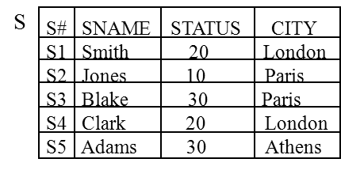
Pointer Chains
  Suppose the query: "Find all suppliers in city xxx" is an important one.
  parent / child organization:
  Advantages:
      1. insert, delete are simpler and more efficient than index structure. (§11-2, Fig. 11-2)
      2. occupy less storage than index structure. (Fig. 11-2)
  Disadvantages:
      to access the nth supplier --> sequential access --> slow !.
Athens
London
Paris
CITY
file
S1 Smith 20
S2 Jones 10
S3 Blake 30
S4 Clark 20
S5 Adams 30
SUPPLIER
file
Fig. 11.6: Example of a parent/child structure

Slide 51
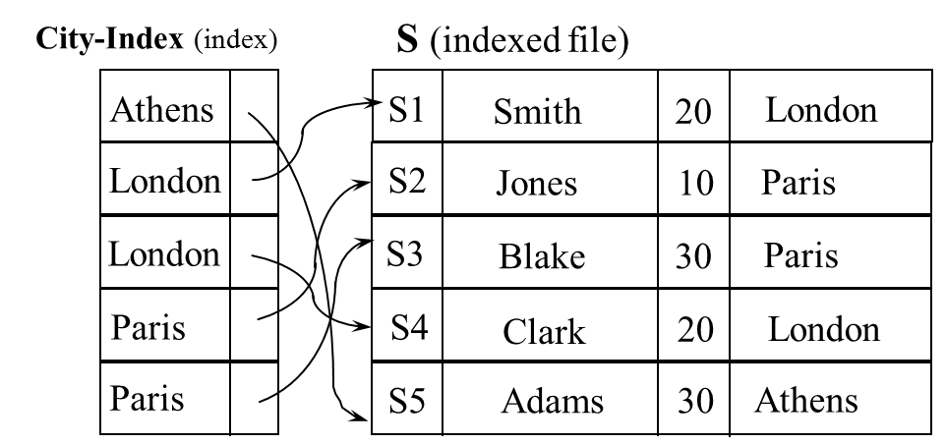
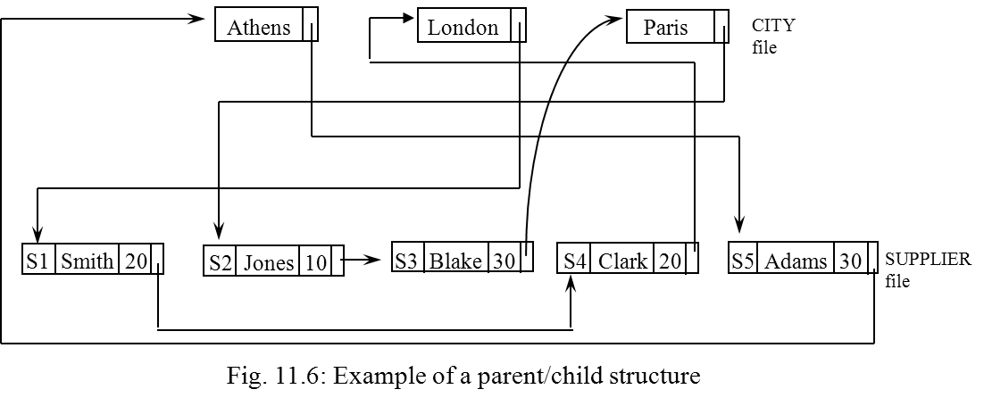
Pointer Chain vs. Indexing
      Compare:
      insert, delete
      Storage
      access the nth record
      sequential access
Fig. 11.2: Indexing the supplier file on CITY.

Slide 52
11.5 Compression Techniques
Objective : reducing storage space
--> reducing disk I/O
Main
Disk
Buffer I/O
index
CPU
index

Slide 53
Differential Compression
  consider a page of entries from an "employee name" index :
-Method 1
front compression:
0 - ROBERTON$$$$
6 - SON$$$
7 - TONE$
3 - INHOOD$$$
ROBERTON$$$$
ROBERTSON$$$
ROBERTSTONE$
ROBINHOOD$$$
6
ROBERT ON$$$$
ROBERT SON$$$
ROBERT STONE$
ROBINHOOD$$$
ROBERTO?????
ROBERTSO????
ROBERTST????
ROBI????????
-Method 2
0 1 2 3 4 5 6 7 8 9 10 11
rear compression: eliminate blanks, replaced by a count.
0 - 7 - ROBERTO
6 - 2 - SO
7 - 1 - T
3 - 1 - I
▼

Slide 54
Hierarchic Compression
  Suppose a file is clustered by same field F (e. g. CITY), and each distinct value of F occurs in several (consecutive) records of that file.
    <e.g.1> intra-file
S
S# SNAME STATUS CITY
S1 Smith 20 London
S2 Jones 10 Paris
S3 Blake 30 Paris
S4 Clark 20 London
S5 Adams 30 Athens
Athens
S5
Adams
30
London
S1
Smith
20
S4
Clark
20
Paris
S2
Jones
10
S3
Blake
30
Fig. 11.7: Example of hierarchic compression (intra-file)

Slide 55
Hierarchic Compression (cont.)
    <e.g. 2> inter-file
S
SP
S
S# SNAME STATUS CITY
S1 Smith 20 London
S2 Jones 10 Paris
S3 Blake 30 Paris
S4 Clark 20 London
S5 Adams 30 Athens
+
page p1
page p2
S1
Smith
20
London
P1
300
S2
Jones
10
Paris
P1
300
P2
200
P3
400
P3
200
P3
200
P2
400
SP
S# P# QTY
S1 P1 300
S1 P2 200
S1 P3 400
S1 P4 200
S1 P5 100
S1 P6 100
S2 P1 300
S2 P2 400
S3 P2 200
S4 P2 200
S4 P4 300
S4 P5 400
P6
100
( and similarly for pages p3, p4, p5 )
Fig. 11.8: Example of hierarchic compression (inter-file)

Slide 56
Huffman Coding
  Consider the coding schemes for {A,B,C,D,E}
    Method 1:
    Method 2:
    Method 3:: Huffman coding
    the most commonly occurring characters are represented
    by the shortest strings.
A: 000
B: 001
C: 010
D: 011
E: 100
average length = 3 bits/char
encoding: 010 100 011
C E D
100%
65%
0
1
Assume: A: 30% - 01
B: 5% - 0000
C: 10% - 0001
D: 20% - 001
E: 35% - 1
0
1
E
35%
35%
0
1
A
15%
D
30%
0
1
20%
A: 1
B: 01
C: 001
D: 0001
E: 0000
B
C
average length = (1+2+3+4+4)/5
= 2.8 bits/char
encoding: 01 0000 001
B E D
5%
10%
average length = 2*30%+4*5%+4*10%+3*20%+1*35%
= 2.15 bits/char
encoding: 01 001 0000
A D B

Slide 57
11.6. Differential File Organization
  (Ref : 1."Differential files : their application to the maintenance of large databases", by D.G. Severance and G.M Lohman, TODS, 1, 3, Sept, 1976.
  2. "A practical guide to the design of differential files for recovery on-line database", by H. Aghili and D.G. Severance, TODS, 7, 4, Dec, 1982 )

Slide 58
Differential File: Basic Idea
  Main file (Primary file) remains static until reorganization.
  Updated records get inserted into differential file.
  To search for a record requires:
      <1> search in the differential file first.
      <2> if not found, then search in the main file.
  Motivation
      reduces dumping cost for backup and recovery
Backup
M.F.
M.F.
M.F.
Time
8:00
10:00
12:00
Tx
(D.F.)
Tx
(D.F.)

Slide 59
Differential File (cont.)
How to access when using differential file?
Record ID
or key
search D.F. index
yes
D.F.
20%
found?
no
search main index
main file
80%
• Disadvantage: requires double index access if data is in main file

Slide 60
Search Filter
Examine
Search
Filter
in M.M.
index of D.F.
D.F.
Record ID
or key
record
in D.F.?
Search
Filter
yes or probably (30%)
M.F. index
Main
Memory
M.F.
search
D.F.
index
No (70%)
found?
Yes
D.F.
20%
No
search main index
main file
80%

Slide 61
Search Filter: Method 1
  Generally employ hash coding technique
    Method 1 : (error free)
b=10
hash table
0
0
0
1
in table
D.F.
1092
0
2
key
h
1092
hash
function
.
.
.
not
main file
1092
92
h(1092) accept
h(2203) reject
h(2092) reject
.
.
.
b: must be large enough
to contain key value

Slide 62
Search Filter: Method 2
Method 2’
      Method 2:
special case
D.F.
0
0
0
0
1092
0
1
0
1
0
2
h(1092) accept
h(2203) reject
h(2092) accept
(a false drop)
.
.
.
0
3
.
.
.
092
92
1
92
1192
.
.
.
.
.
.
c < b c = 3
c = 1 bit
      Advantage: smaller space overhead
      Disadvantage: false drops occasionally occur
    <Note>: the larger the hash space is, the smaller the false drop probability

Slide 63
Search Filter: Method 3 - Bloom Filter
    Method 3: Bloom Filter (ref : B.H. Bloom, "space/time trade offs in hash coding with allowable errors", CACM,1970)
    fails drop probability depend on
      k: # of hash function used
      F: size of hash space
      N: # of keys to be stored in hash space.
bit map
0
0
.
.
.
all 1's
h1
1
9
D.F.
1
10
key
h2
.
.
.
<e.g> : k=3
N = 1000
F = 5000 Pfd = 0.0919
F = 10000 Pfd = 0.0174
.
.
.
main file
1
92
.
.
.
some
are 0's
h3
0
Error
F-1
<e.g.> h1(1092) = 92
h2(1092) = 09
h3(1092) = 10 h_{i} ≠ h_{j} , i ≠ j
#-of hash function
1 2 3 4

Slide 64
Our Research Results: Method 4 - Random Filter
Method 4: Random Filter
C. R. Tseng and W. P. Yang,
“2D Random Filter and Analysis,”
International Journal of Computer Mathematics,
vol. 42, pp. 33-45, 1992.
bit map
0
0
.
.
.
all 1's
h1
1
9
D.F.
1
10
key
h2
.
.
.
.
.
.
main file
1
92
some
are 0's
h3
.
.
.
0
F-1

Slide 65
end of unit 11

